Slide 1
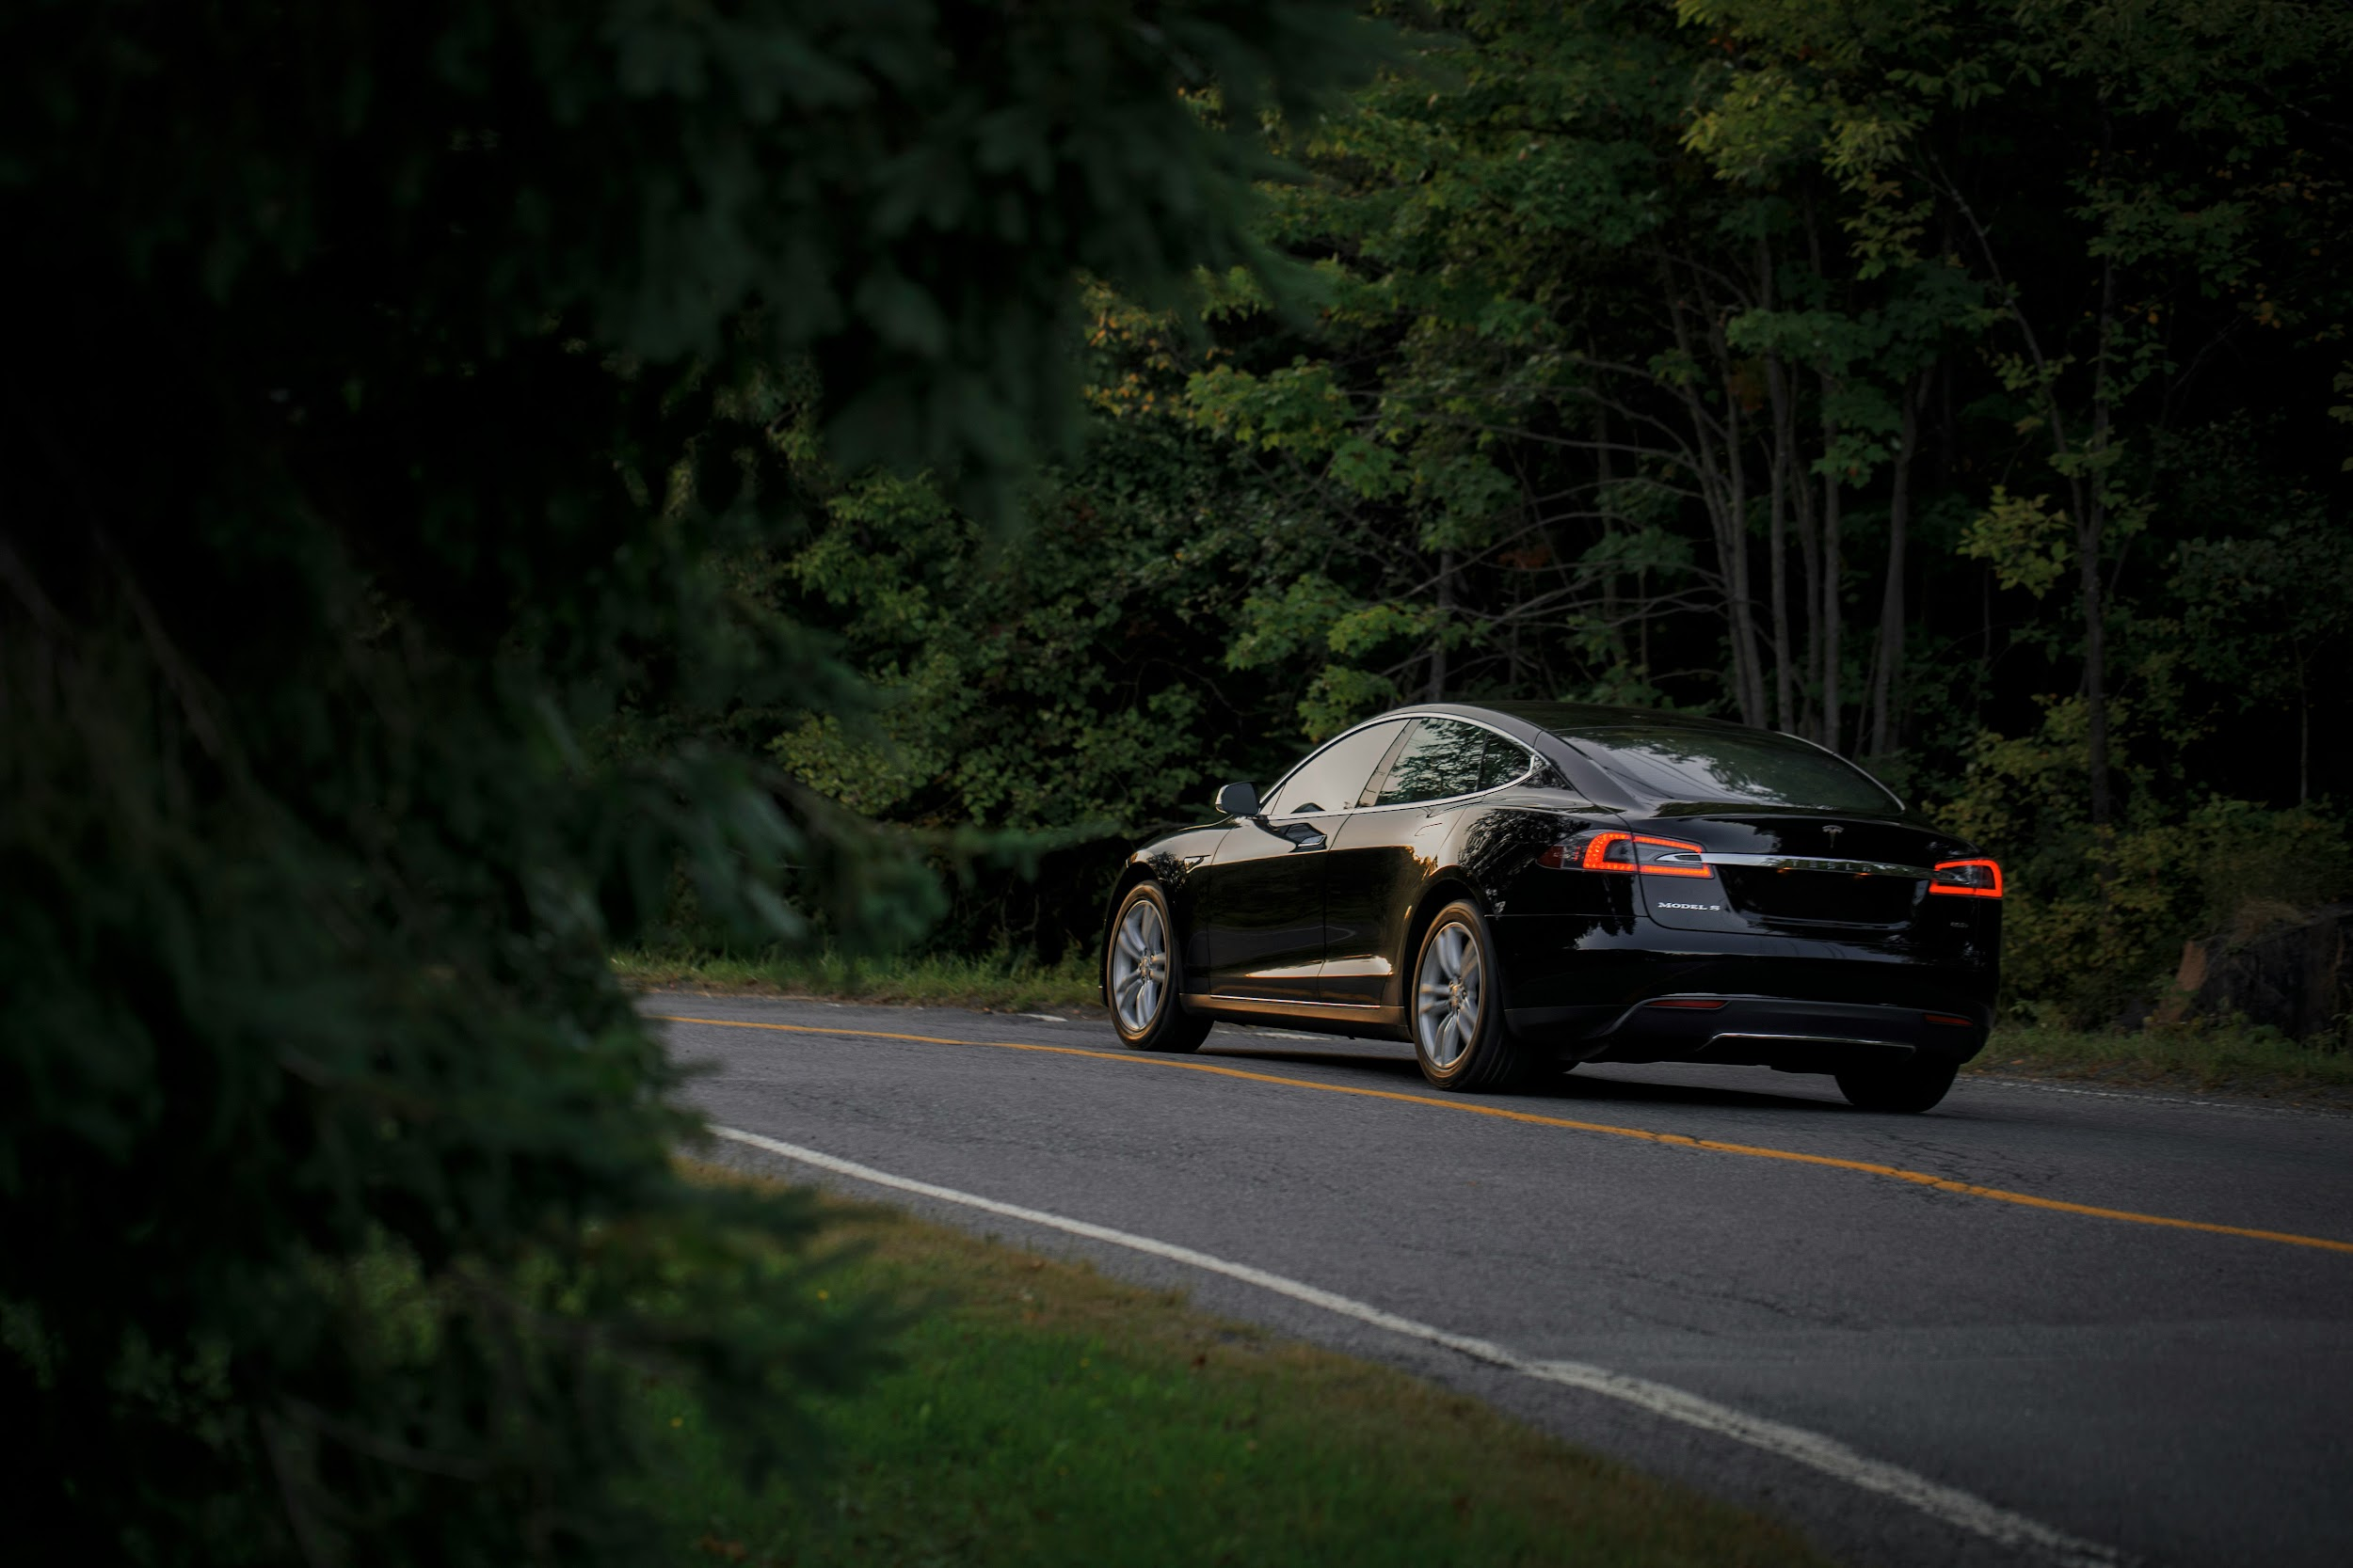
Washington State Electric Vehicle Trends
A presentation by Holly and Tony

Slide 2
The Electric Vehicle Takeover
Major car manufacturers converting to 100% Electric Vehicles
Jaguar (2025)
Chrysler (2028)
Aston Martin (2030)
Bentley (2030)
Buick
Cadillac (2030)
Lexus (2030)
Maserati (2030)
Mazda (2030)
Mini (2030)
Rolls-Royce (2030)
Volvo (2030)
Audi (2033)
GMC (2035)
Acura (2040)
Honda (2040)

Slide 3
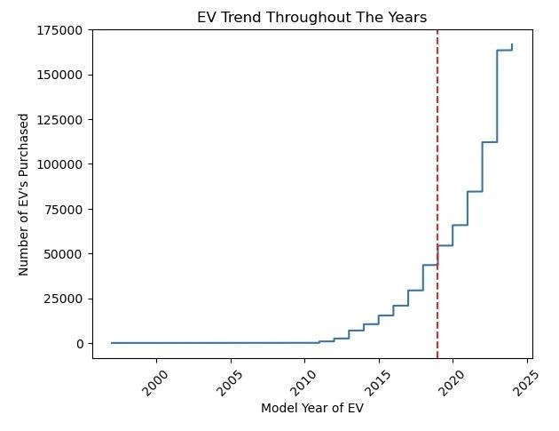
Tax incentive as of August 2019, buyers can avoid paying sales tax up to $25000
Notes:
goal is to answer “if drivers outside of major cities need to drive farther with EV’s”

Slide 4

Do drivers outside of major cities have more range with their EV’s due to the simple fact of having to drive further?

Slide 5
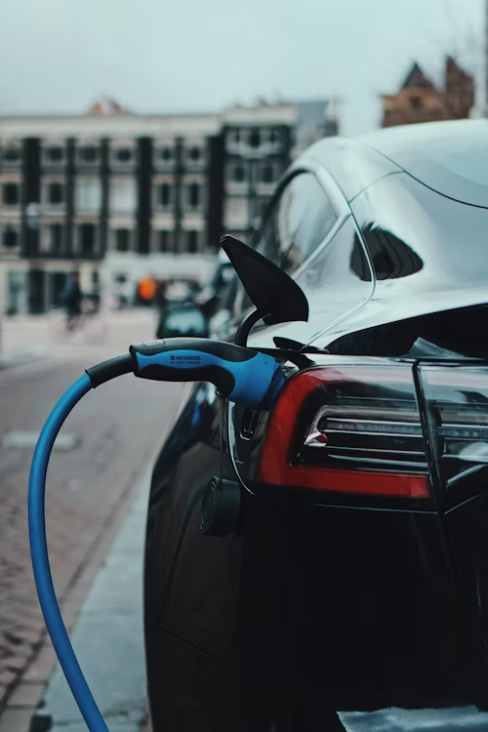
Hypothesis: Those who live in rural areas of Washington State own EV’s that have greater range.
Null Hypothesis: Owners of EV’s that live in dense, urban environments typically have greater electric range.

Slide 6
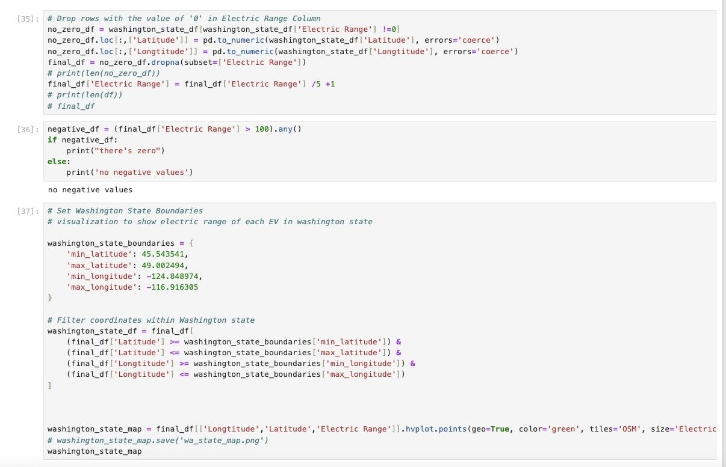

Slide 7
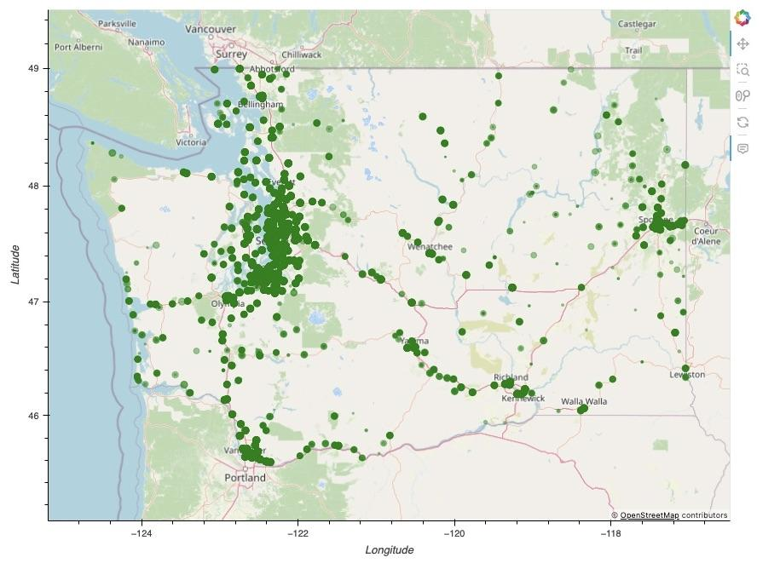
Location of EV’s in WA
Null Hypothesis proved to be correct! Those in urban areas have EV’s with further range.
(Size of each dot represents electric range of the vehicle)

Slide 8
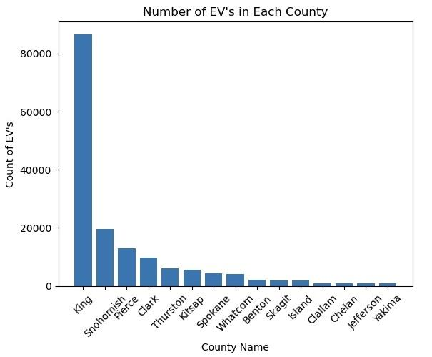
Electric Vehicles Per County
King County Cities:
Seattle (pop. 733,919)
Kent (pop. 134, 835)
Bellevue (pop. 149, 440)
Snohomish County Cities:
Snohomish (pop. 10,154)
Everett (pop. 110,812)
Lynnwood (pop. 40,592)

Slide 9
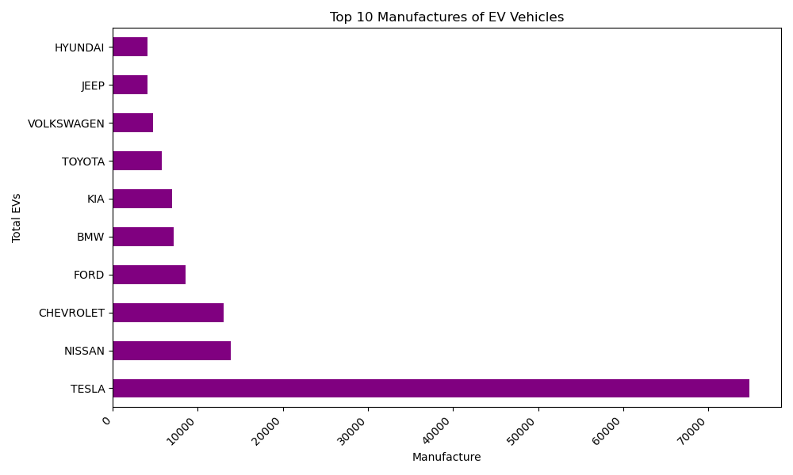
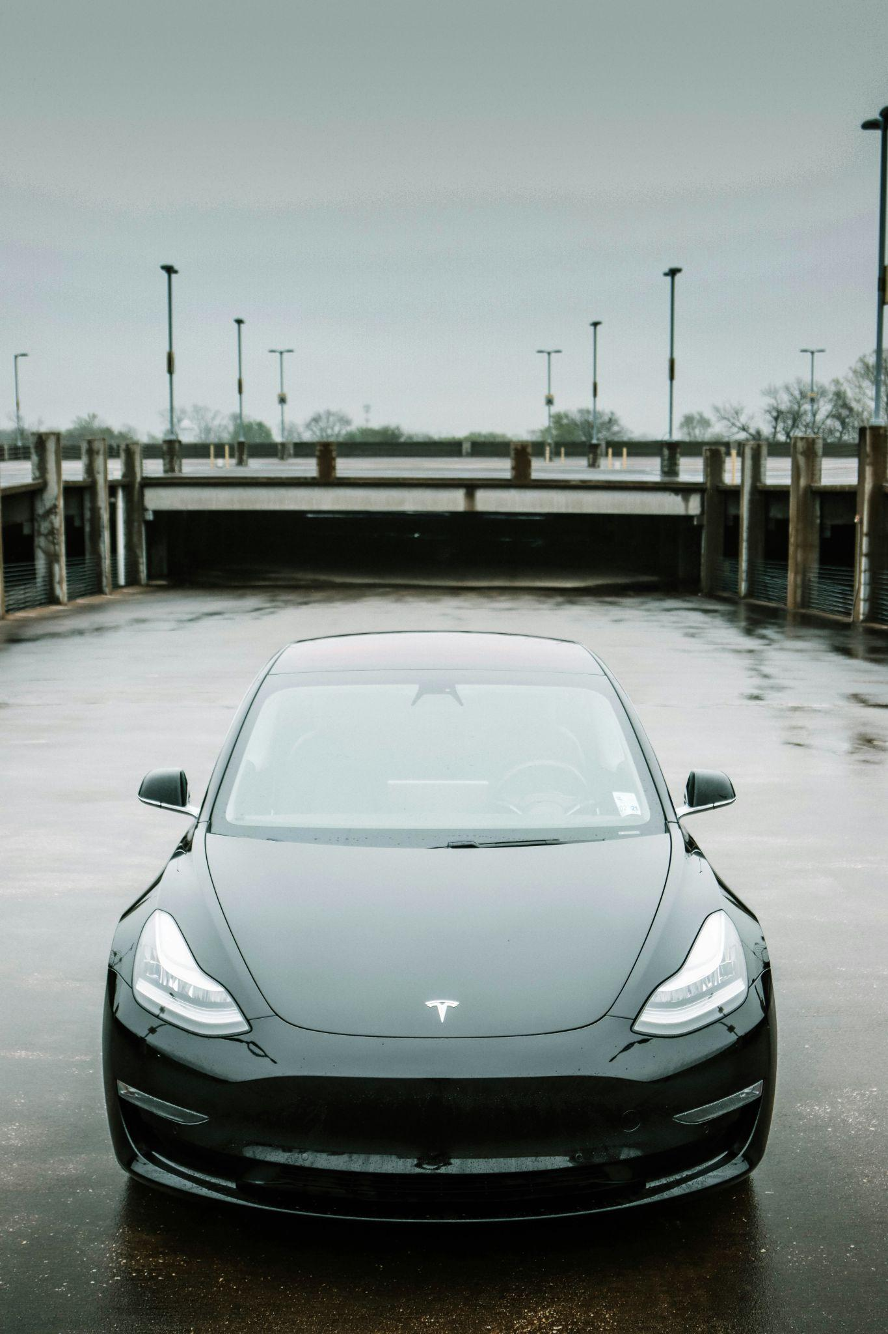
Most Popular Electric Vehicles In Circulation
Notes:
As we saw in Tony’s slide earlier, electric vehicle ownership skyrocketed starting in 2019. We then looked at additional trends with electric vehicles to determine if we could gain additional insight behind the spike in EV ownership.
Regardless of the $75/year fee that WA state is charging…. Interest remains strong 166,800 over 27 year period - 3,309 so far just this year.
According to the U.S. Energy Information Administration WA has one of the highest percentages of registered plug-in electric cars in the country, Tesla remains the favorite among electric vehicle owners.
However, regardless of the local incentives in place there isn’t much choice for consumers when it comes to manufacturer's to choose from according to a recent Seattle Times blog post.
Manufacturers aren’t incentivized to produce more electric vehicles for sale in Washington state as the state hasn’t adopted zero emissions policies like California
Should we see stricter legislation from either the state or local governments, with more lower cost EVs available for purchase we would expect to see EV ownership higher than it is today
Manufacture & total EVs are independent variables, there is no correlation between the two (Cramer's V: 0). Cramer’s is a chi-square test to measure how strong two categorical fields are associated. Chi test measures input against expected output for categories

Slide 10
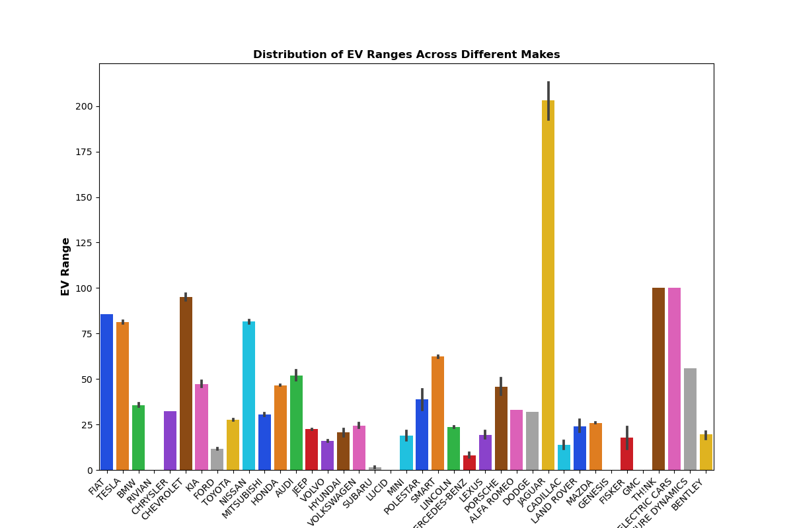
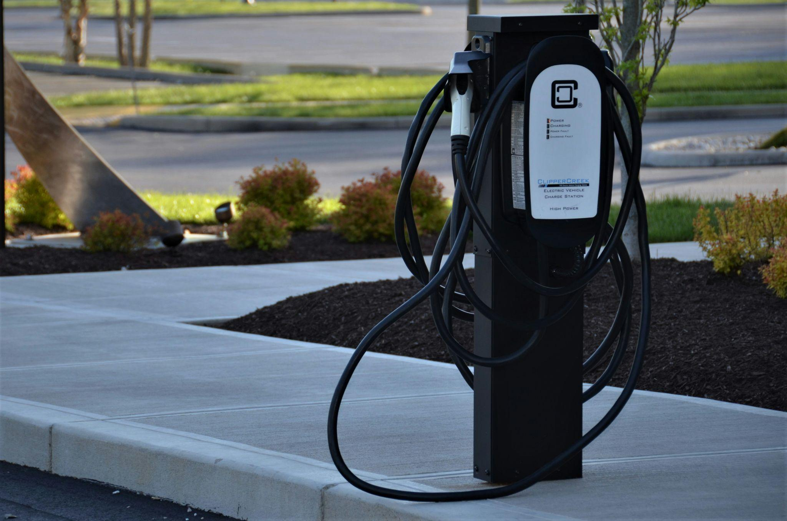
Electric Vehicle Range Distribution
Notes:
The first of two trends we investigated to determine if there was any correlation was the distribution of the electric vehicle range and the manufacture.
We found no correlation between the distribution of the EV range and the manufacture. No additional insight can be found into the EV ranges by knowing the manufacture
However, looking at the graph depicted you can see with the exception of the Jaguar most ranges fall in the 25 to 50 mile range
Weak positive correlation Pearson Correlation Coefficient: 0.07193586773978594 super weak close to zero

Slide 11
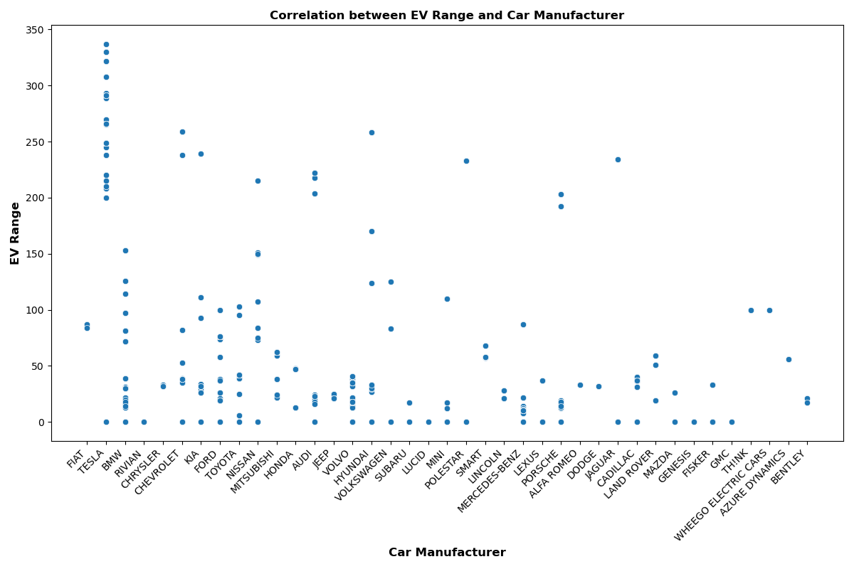
Correlation Between Electric Range and Manufacture
Notes:
Then we looked at a scatterplot view..
Could we determine a correlation between EV range and vehicle manufacture – NOPE
Weak positive correlation Pearson Correlation Coefficient: 0.07193586773978594. Small tendency for increase in car manufacture for an increase in EV range but super weak close to zero
No additional insight can be found into the EV ranges by knowing the manufacture

Slide 12

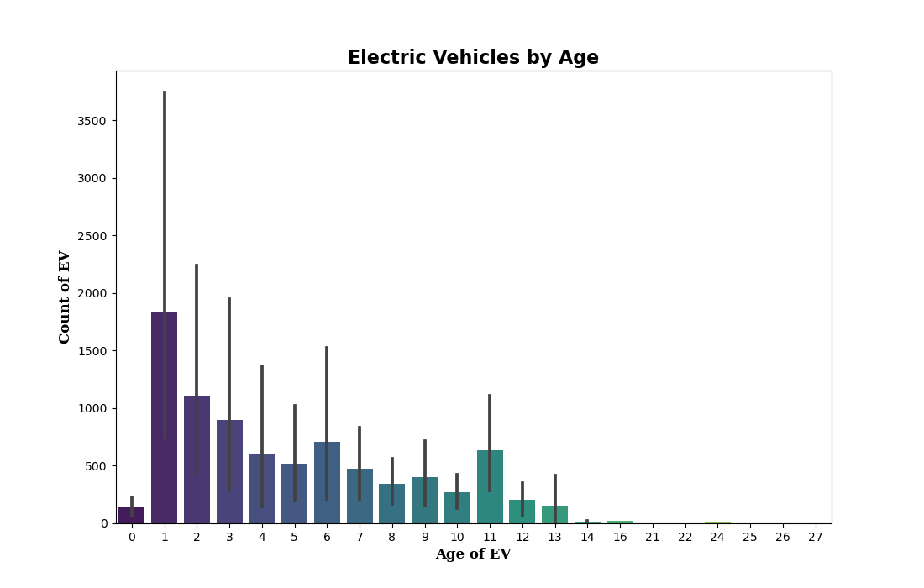
Where Are All The “Old” Electric Vehicles?
Notes:
Then lastly, we investigated the relationship between the age of the electric vehicle and the amount of electric vehicles in circulation
There are a number of rebates/incentives available for consumers purchasing new vehicles.
Federal and local incentives
Electric cars get a sales-tax exemption in Washington up to $25k as Tony mentioned earlier, and as we saw in the urban cores drivers have access to more charging infrastructure
Newer technology
which might explain the lack of older vehicles on the road ….. However, we found no correlation between the number of EVs on the road and the age of the vehicle (Correlation between Age and Count: -0.12888215071722858 = weak negative correlation negative number & far from 1. Increase in age small decrease in count

Slide 13
Conclusion
Urban areas have a higher concentration of electric vehicles
No other correlations found in the data for:
Between the car manufacture and the electric range
The age of the vehicle and the number of vehicles in circulation
Electric vehicles remain popular with consumers in Washington State

Slide 14
Appendix

Slide 15
References
Sea-Tac Establishes Environmental Guidelines for Ridesharing Companies. Retrieved from https://airportimprovement.com/article/sea-tac-establishes-environmental-guidelines-ridesharing-companies. On January 30,2024.
Since 2003, SEA has required taxis servicing the airport to meet various environmental standards. Now, it is applying the same criteria to ridesharing companies as well. Ridesharing companies are required to adhere to the Port's Environmental Key Performance Indicator (E-KPI), which establishes a threshold for emissions based on a fleet's weighted average mile-per-gallon performance, deadheading statistics, and pooling of passengers who are otherwise unaffiliated. If companies do not meet the environmental performance standards after six-month and nine-month periods, they incur additional $5 per trip fees until they achieve the Port's green benchmarks.
HB 2042 Passes Washington Legislature. Retrieved from https://forthmobility.org/news/hb-2042-passes-washington-legislature. On January 30, 2024. May 2019 state incentives for purchasing EVs were extended, state funding extended to projects in low income/rural areas, funding & grants for studies targeted to low to middle income residents
Washington-state-loves-electric-cars-but-gets-very-few-heres-why. Retrieved from https://www.greencarreports.com/news/1098052_washington-state-loves-electric-cars-but-gets-very-few-heres-why. On January 30,2024. It has one of the highest percentages of registered plug-in electric cars in the country, according to the U.S. Energy Information Administration. Electric cars get a sales-tax exemption in Washington, and access to charging infrastructure that's fed mostly from wind and hydro power.
washington-state-is-charging-hybrid-owners-75-to-incentivize-electric-cars. (Oct 4, 2019). Retreived from https://www.greencarreports.com/news/1125362_washington-state-is-charging-hybrid-owners-75-to-incentivize-electric-cars. On January 30, 2024
State of washington building ‘electric highway system’ allowing for longer range trips. Retrieved from
https://www.commerce.wa.gov/growing-the-economy/energy/electric-vehicles/resources-govt-agencies/ On February 4, 2024
Images courtesy of https://unsplash.com/s/photos/electric-car

